Slide 1
Application development
Sw601f12-PARROT

Slide 2
Multi Project
Multi project
Target group
Guardians
Children with ASD
Development method
Agile and scrum
Our development method.

Slide 3
Multi Project cont.
Problem definition
How can we ease the daily life for children with ASD and their guardians, while complying with the study regulation?

Slide 4
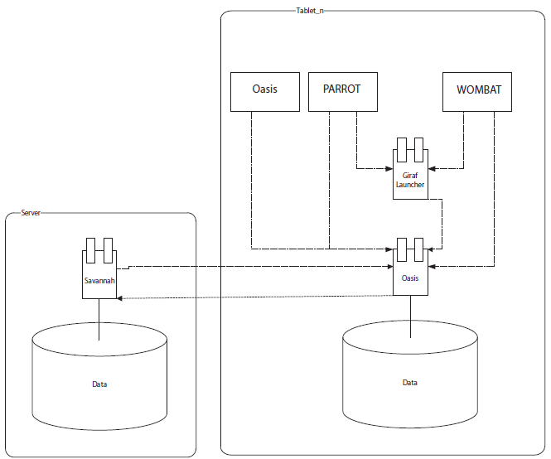
Multi Project cont.
System description & architecture.

Slide 5
Analysis
Meeting with Tove

Slide 6
Application Design
Design Choices
Feature choices

Slide 7
Implementation
Features/functions

Slide 8
Testing
Ad-hoc testing
Quality improvement on the run.
Dynamic Black box testing
Quality assurance according to the specification.
Usability testing

Slide 9
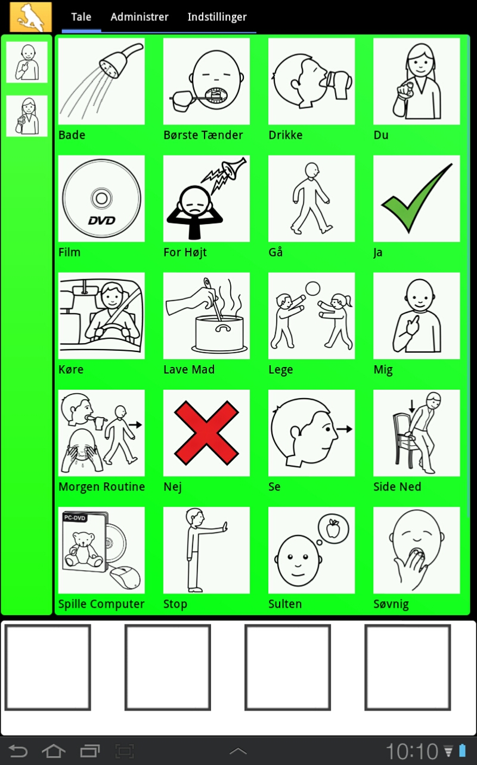

Slide 10
Epilog

